Slide 1

Dungeon Monkey
By- Aradhya,Anshaj,Soham,Hrishi etc

Slide 2
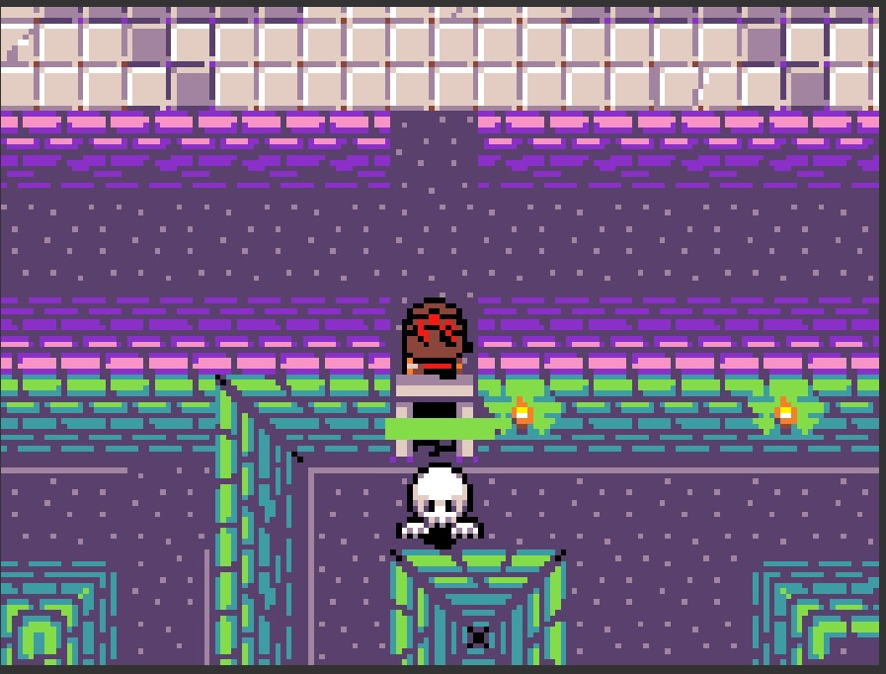
The Game
It is called dungeon monkey it is a single player fun game in the game you are walking while you fell into a ditch which led you to a secret dungeon you have to escape without being killed . The game consist of all kinds things for eg a hostile enemy
It consist of different level too

Slide 3
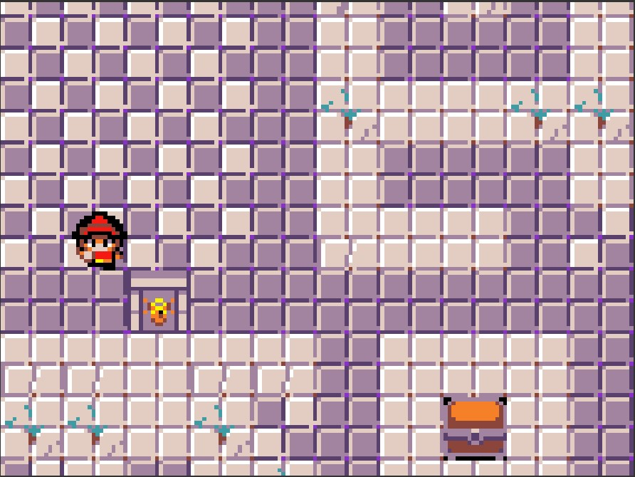
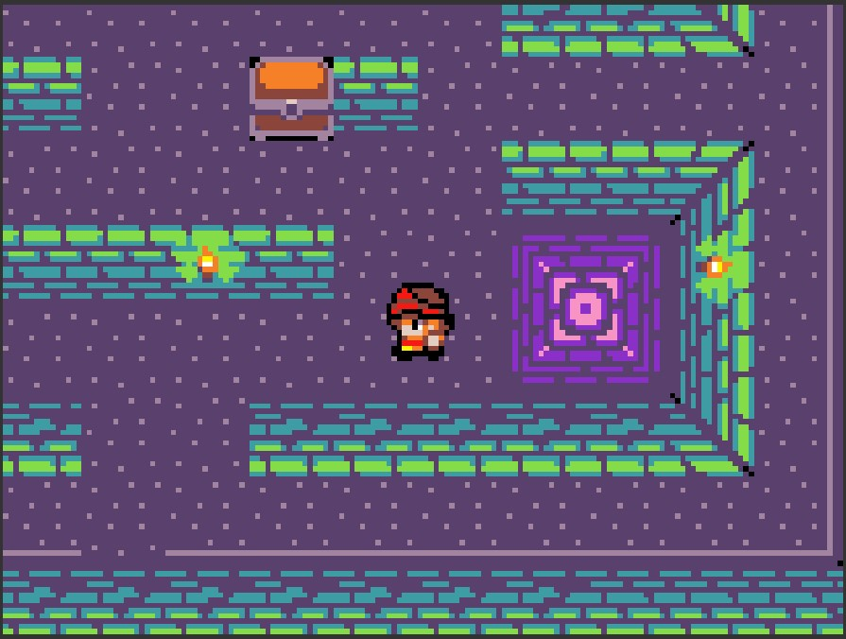
More screenshots from the game

Slide 4
Link to the game
https://arcade.makecode.com/S84588-28195-98908-63643

Slide 5


